Slide 1

Balloon Sat Arduino Shield Project
Michael Kurta

Slide 2
TABLE OF CONTENTS
01
02
PHASE 1
Design and Process
PHASE 2
A more thorough approach

Slide 3
01
PHASE 1

Slide 4
Original Design - BOM
1x Arduino Uno
1x 9V battery
1x 9V battery to Arduino Barrel Jack
1x PCB to function as a shield for Arduino
1x Sparkfun OpenLog module (UART)
1x Honeywell HH-4030 Humididy Sensor Module (No longer in production)
1x Adafruit ADXL 335 Accelerometer Module
1x Sparkfun Qwiic Micropressure Sensor
2x Analog Devices TMP36 Temperature Sensors
2x Blue 5mm LEDs
1x Orange 5mm LED
1x Yellow 5mm LED
1x Green 5mm LED
1x Red 5mm LED
2x 8-Pin stackable plug headers
2x 6-Pin stackable plug headers
2x DIP socket halves
2x 6-Pin socket headers
1x 3-Pin socket header
2x 2-Pin plug breakaway headers
1x 3-Pin locking headers
1x 6-Pin breakaway header
1x 3-Pin plug breakaway header

Slide 5
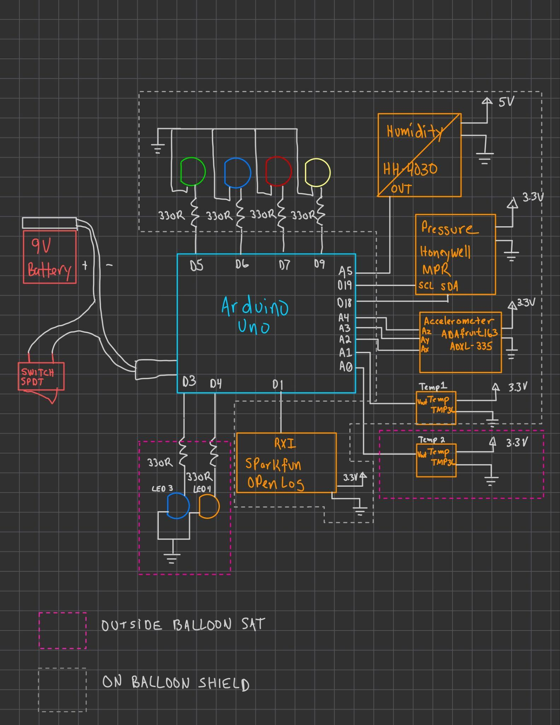
Original Design - Block Diagram

Slide 6
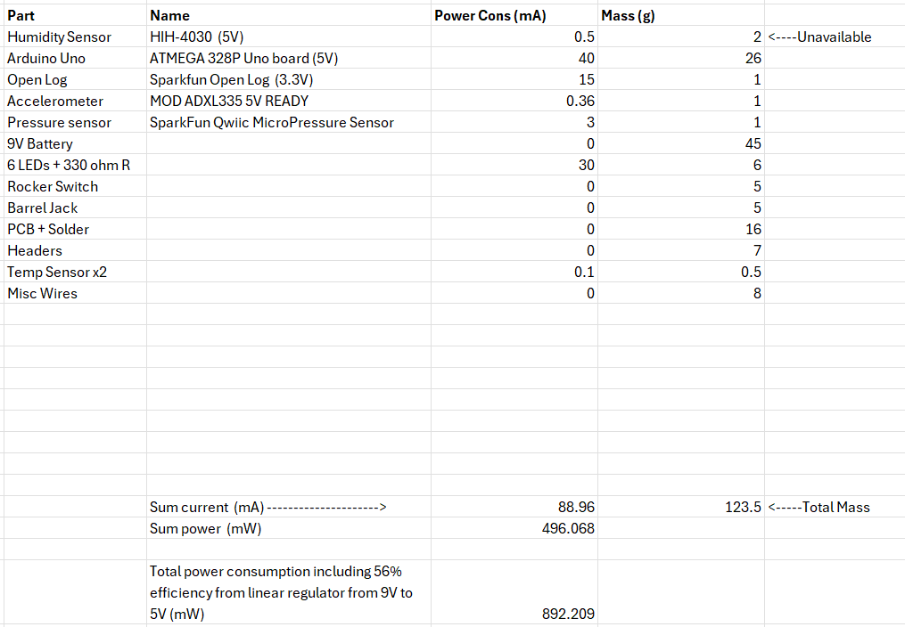
Original Design - Weight / Power
Cost ~$110

Slide 7
02
PHASE 2

Slide 8
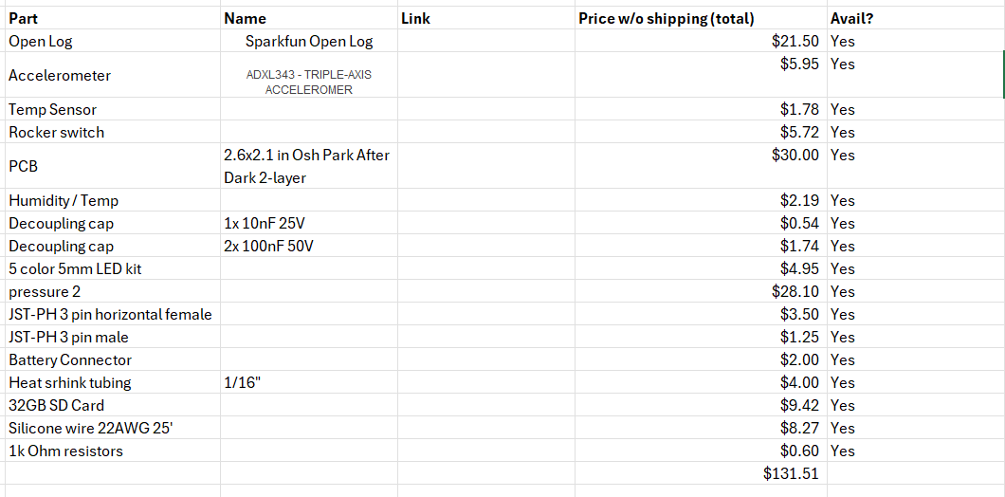
PHASE 2 - BOM

Slide 9
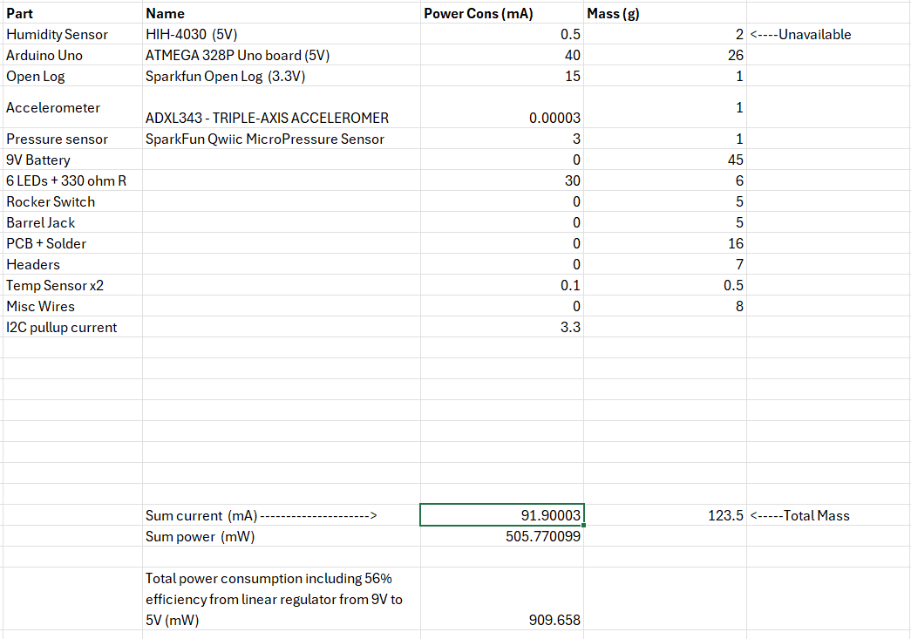
PHASE 2 - Weight and Power

Slide 10
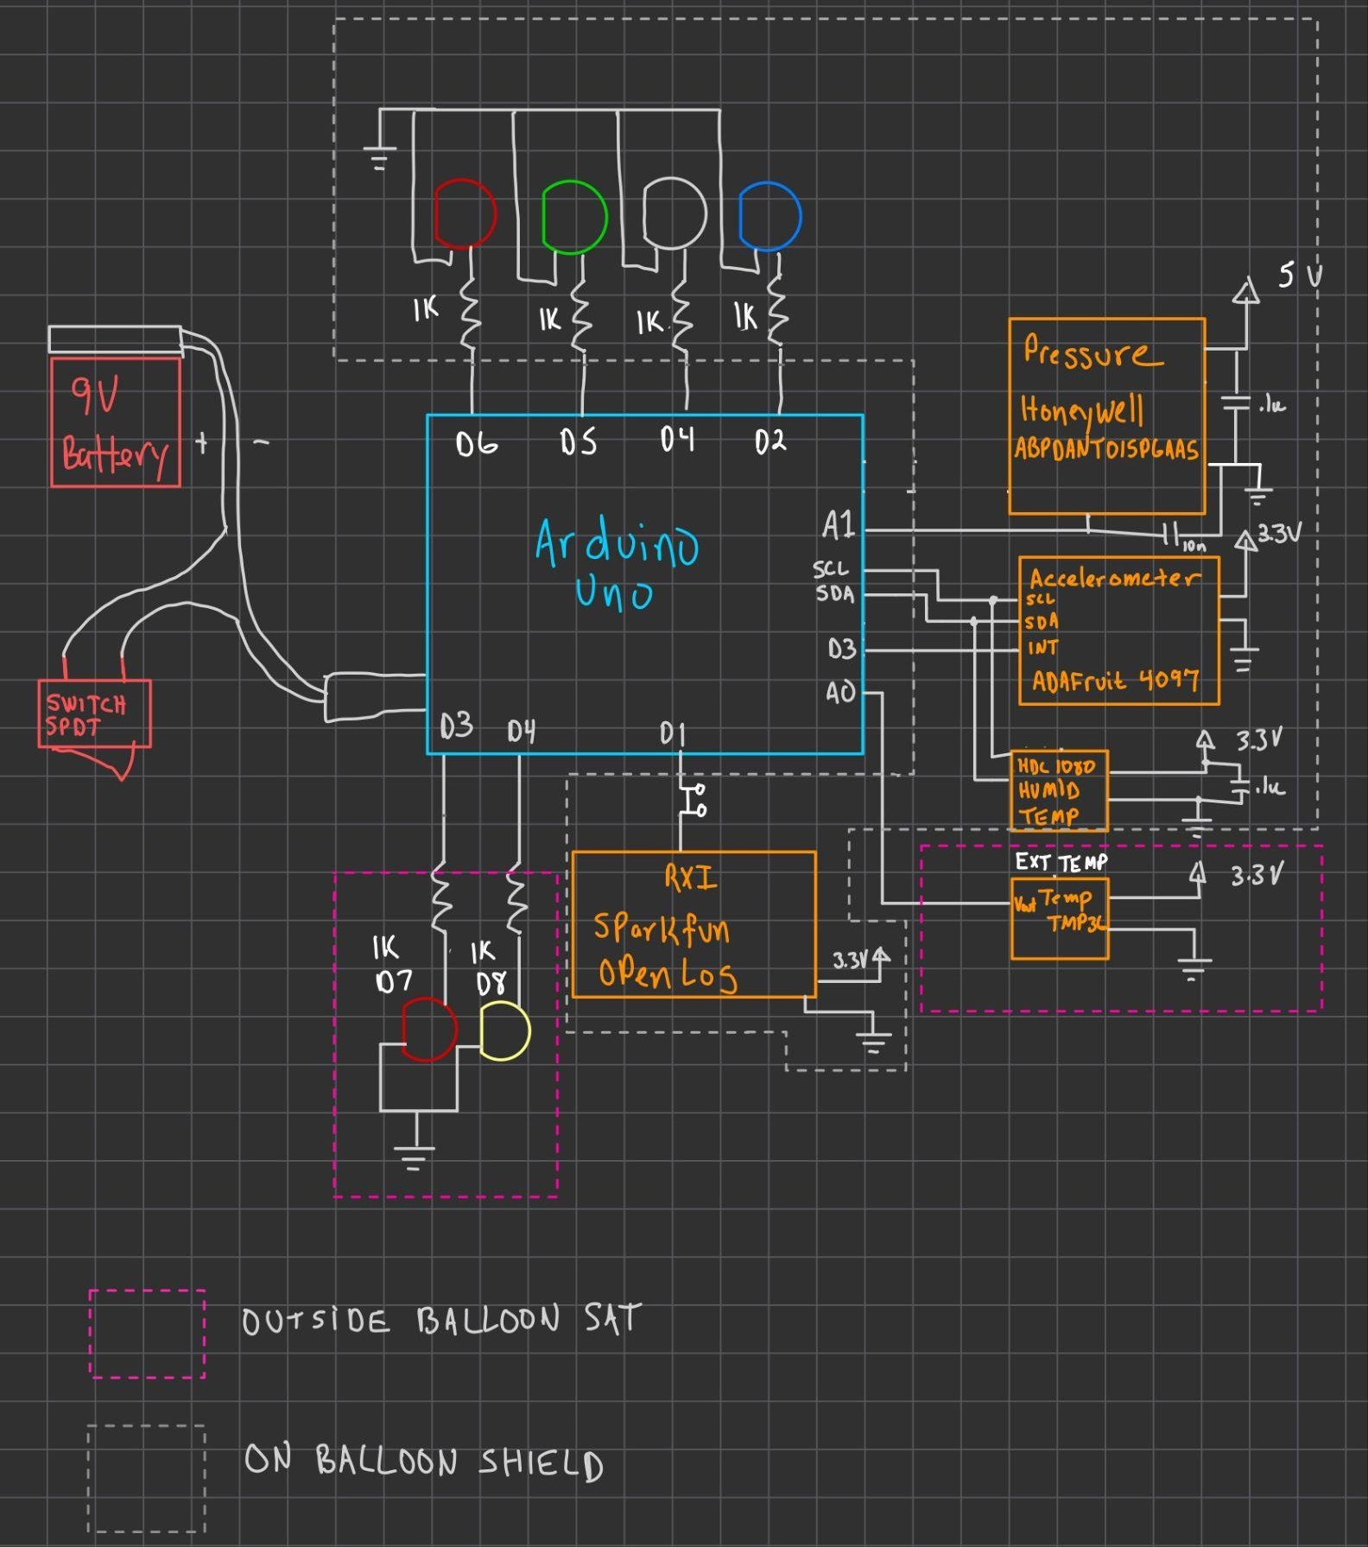
PHASE 2 -
Block Diagram

Slide 11
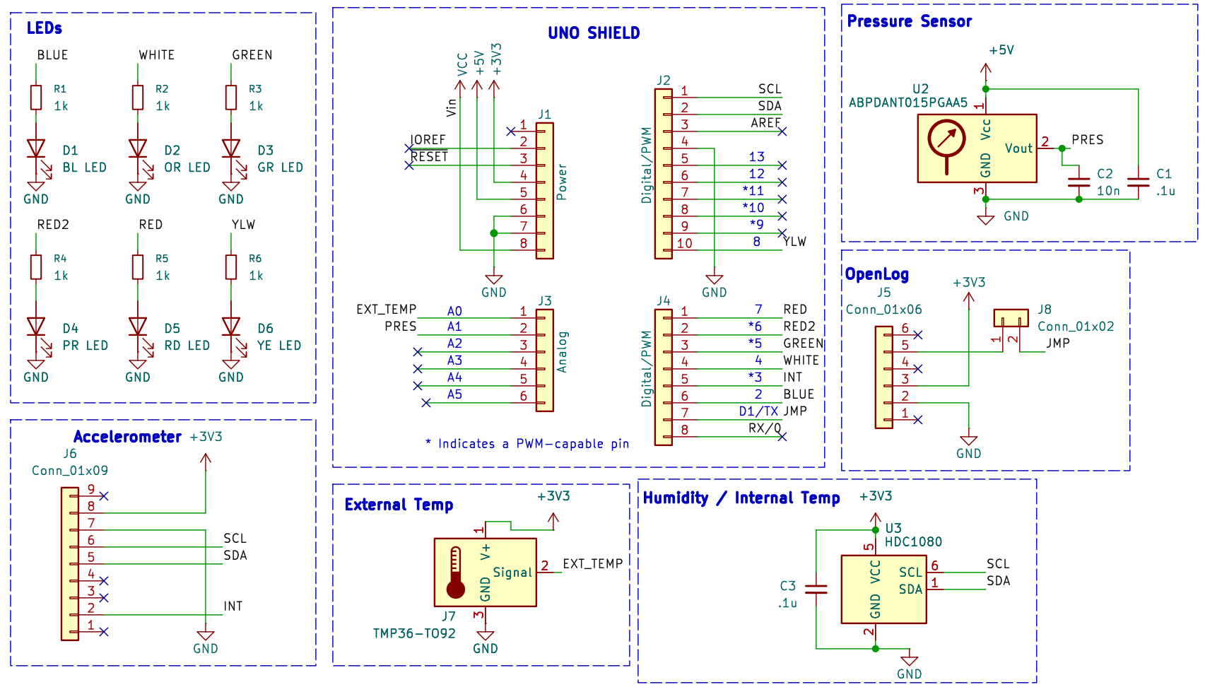
PHASE 2 - Schematic

Slide 12
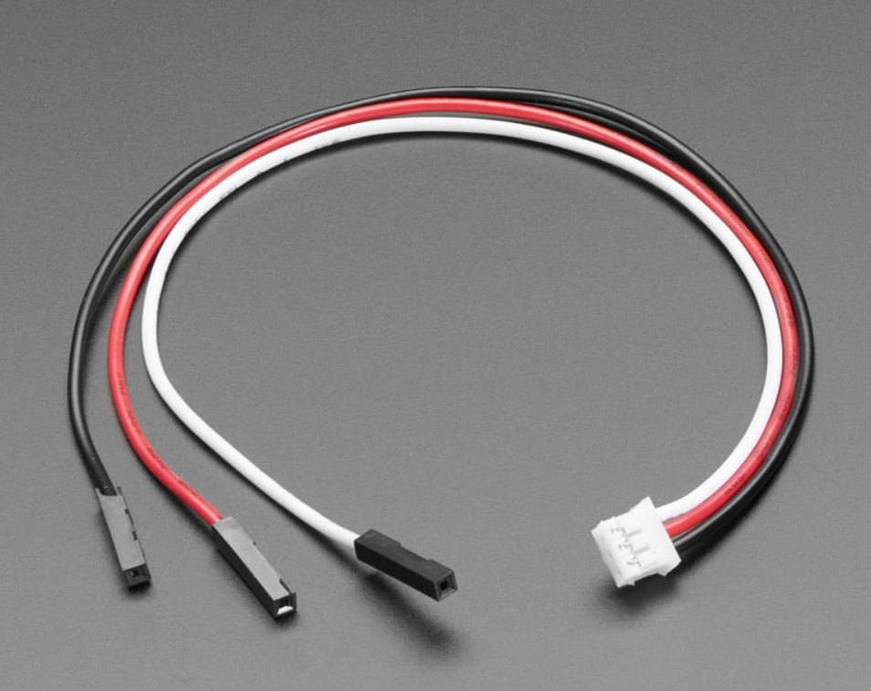
PHASE 2 External Temp Connector

Slide 13
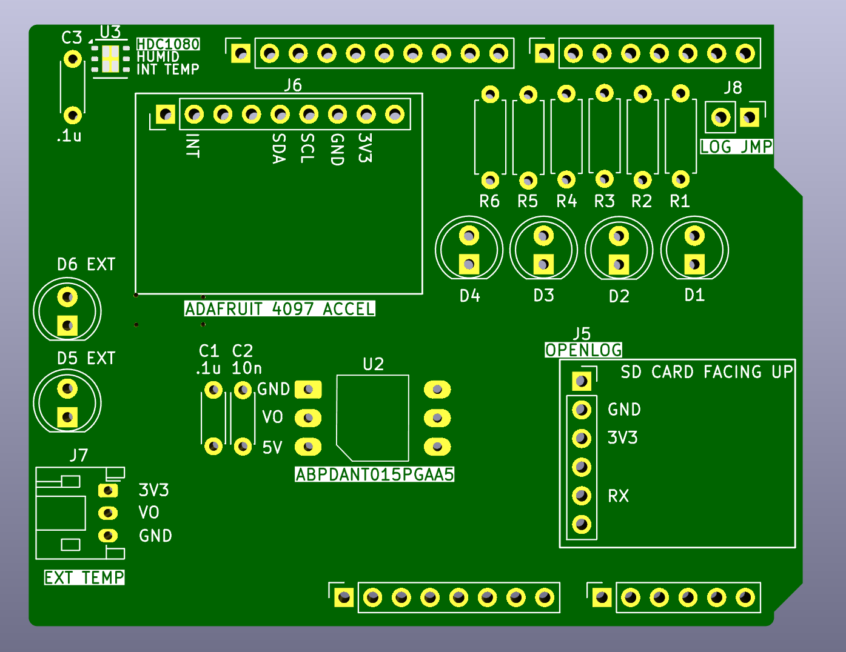
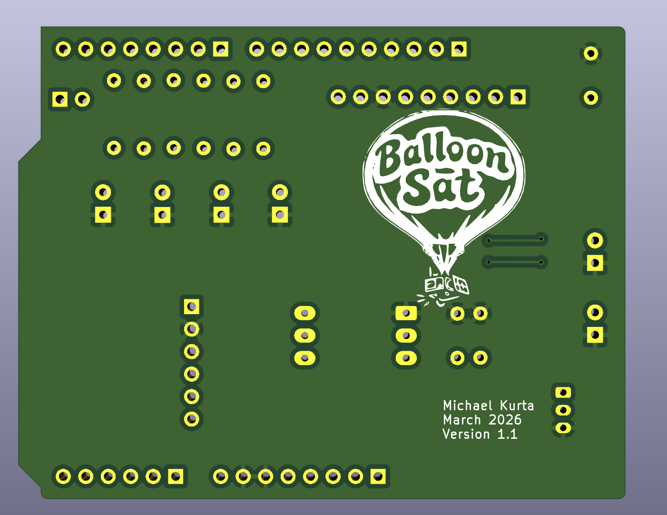
PHASE 2 - PCB

Slide 14
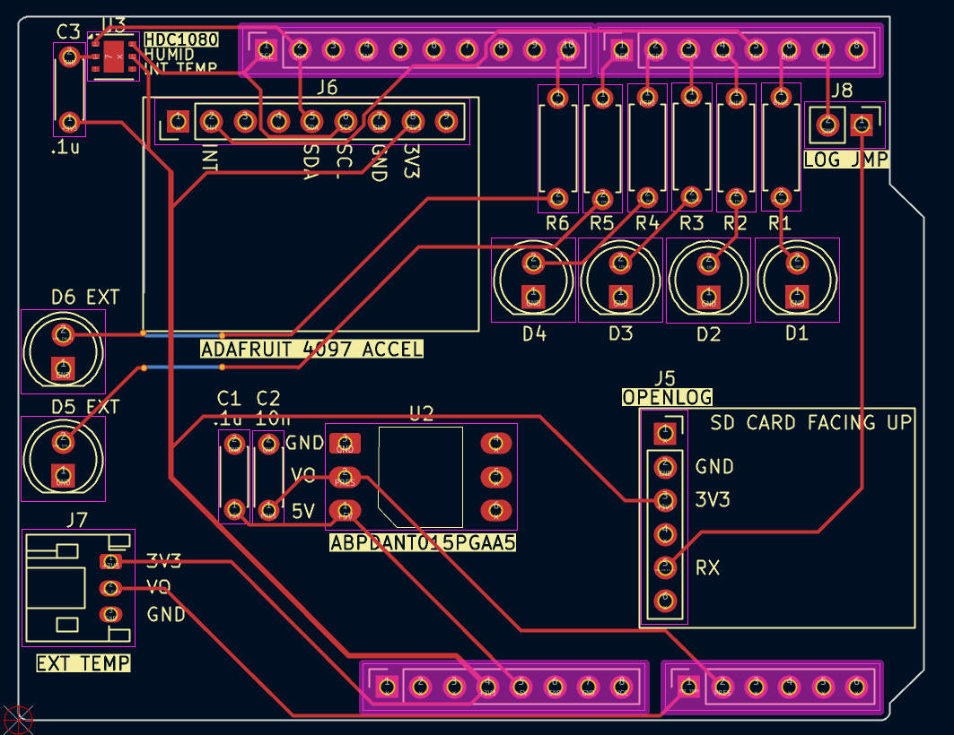
PHASE 2 - PCB

Slide 15
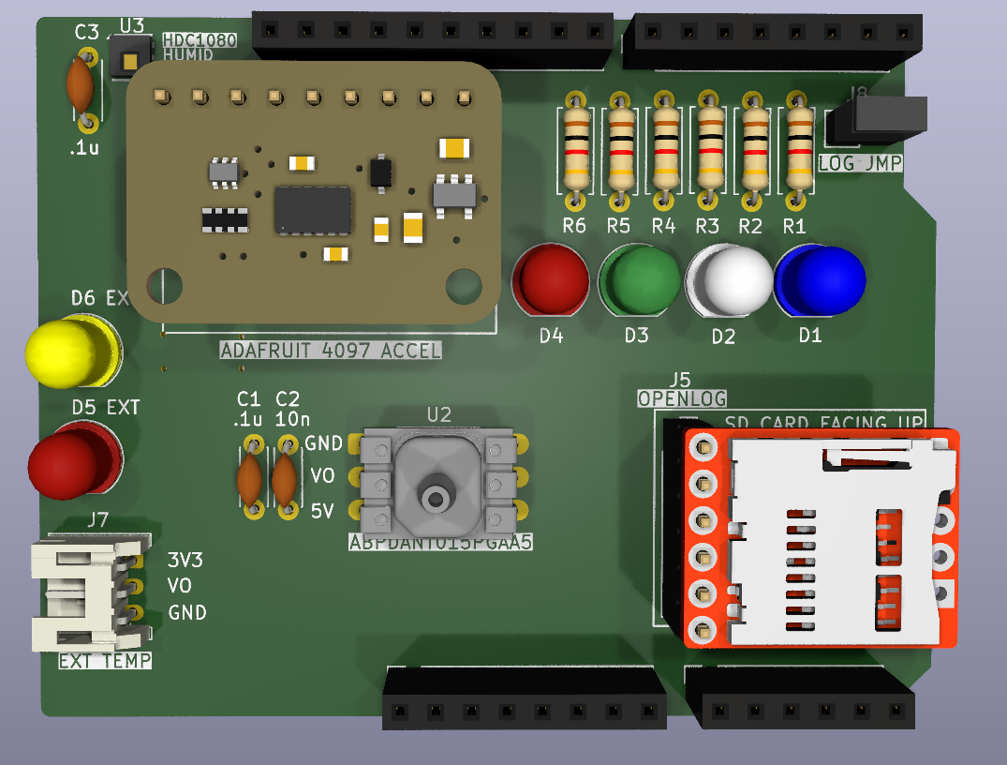
PHASE 2 - PCB & Features
Connector for external Temp sensor
Decoupling capacitors
No additional I2C resistors
Easy access SD card
All external wiring in one area on the
board
Jumper to prevent bootload writes
to SD card
Dual-use temp / humidity sensor
Part orientation easily marked
Accelerometer INT pin connected to
Arduino interrupt trigger pin

Slide 16
THANKS!
Please keep this slide for attribution

